Slide 1
Statistics

Slide 2
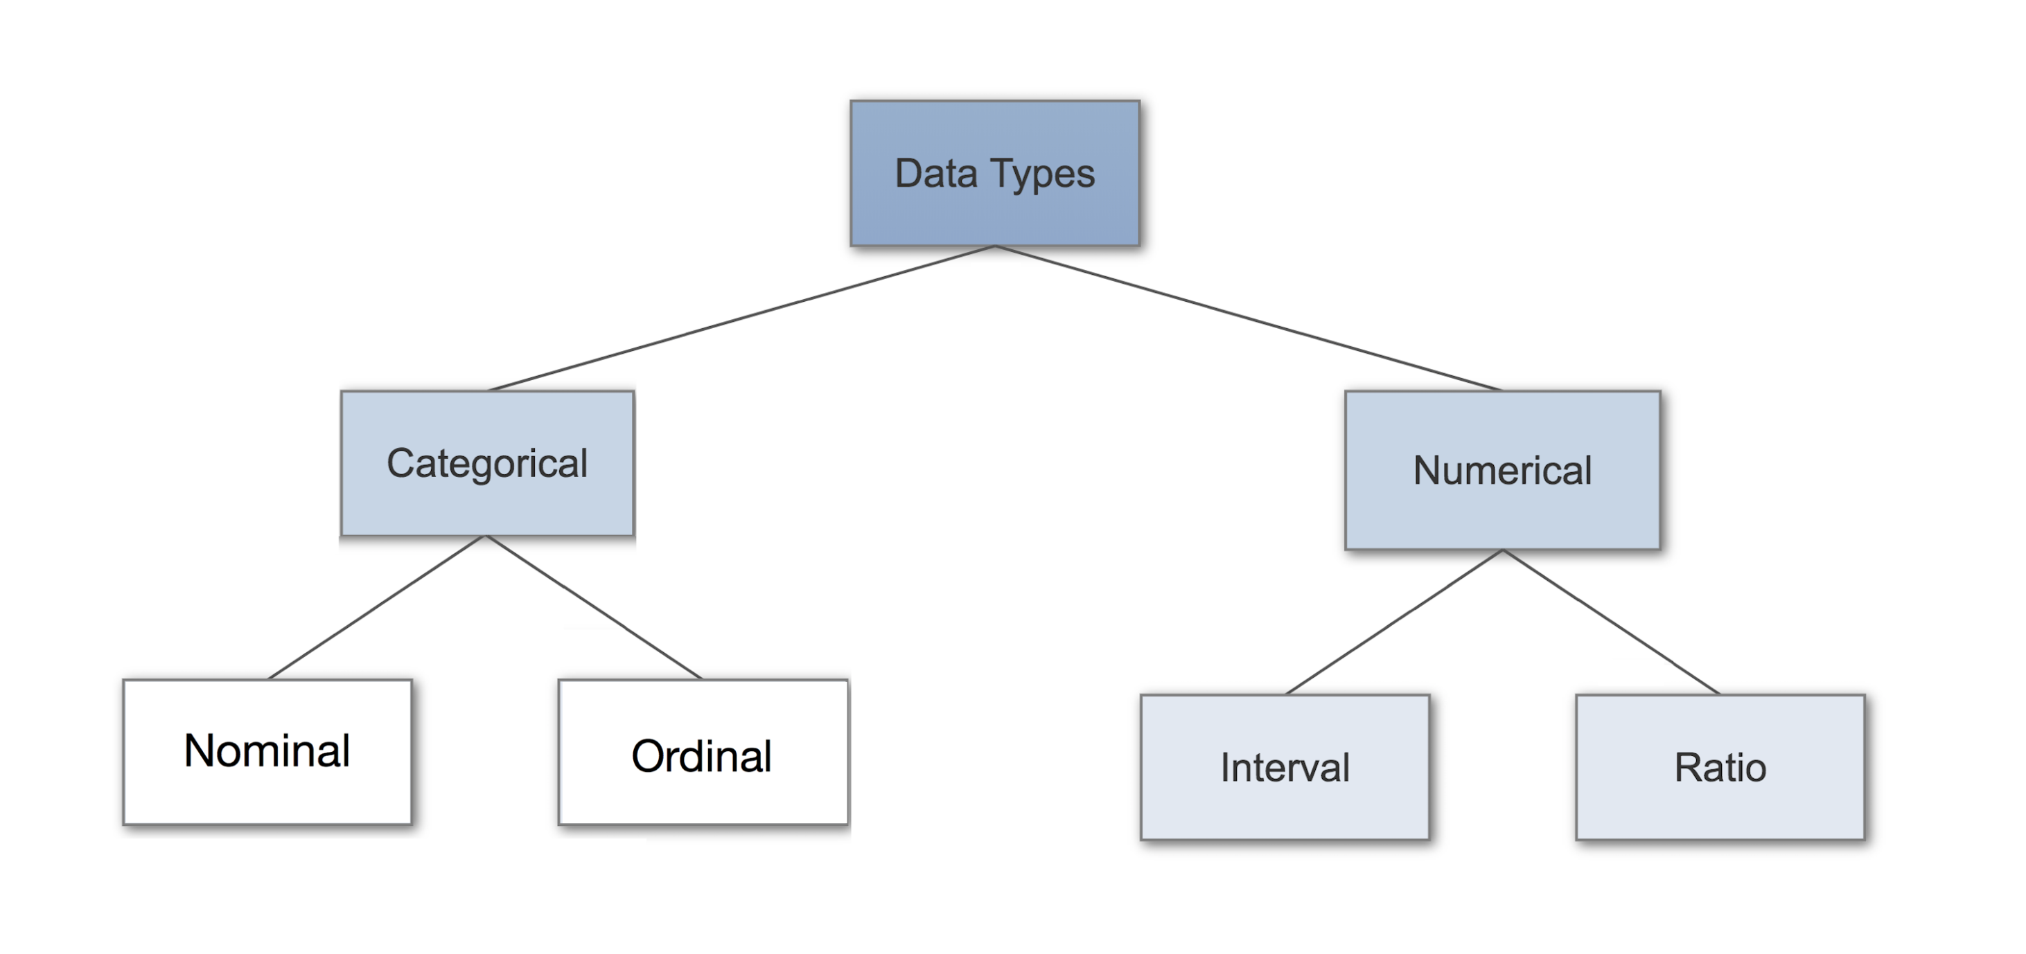
Data Types.

Slide 3

Nominal Data
Nominal values represent discrete units and are used to label variables, that have no quantitative value. Just think of them as „labels“. Note that nominal data that has no order. Therefore if you would change the order of its values, the meaning would not change.

Slide 4

Ordinal Data
Ordinal values represent discrete and ordered units. It is therefore nearly the same as nominal data, except that it’s ordering matters. You can see an example below:

Slide 5
Numerical Data
1. Discrete Data
We speak of discrete data if its values are distinct and separate. In other words: We speak of discrete data if the data can only take on certain values. This type of data can’t be measured but it can be counted.
2. Continuous Data
Continuous Data represents measurements and therefore their values can’t be counted but they can be measured. An example would be the height of a person, which you can describe by using intervals on the real number line.

Slide 6
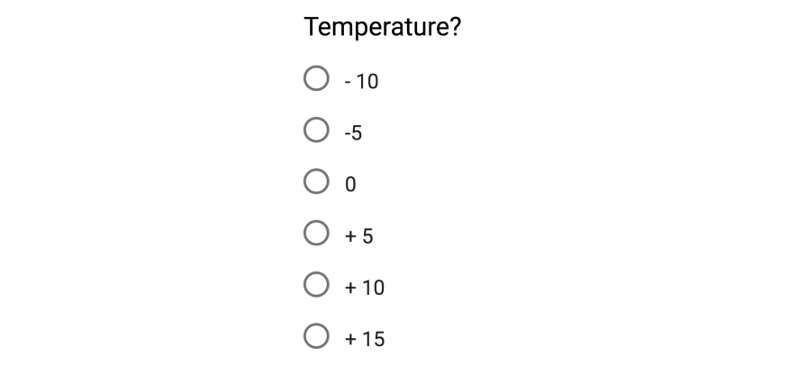

Interval Data
Interval values represent ordered units that have the same difference. Therefore we speak of interval data when we have a variable that contains numeric values that are ordered and where we know the exact differences between the values.
Ratio Data
Ratio values are also ordered units that have the same difference. Ratio values are the same as interval values, with the difference that they do have an absolute zero.

Slide 7
Measure of Dispersion
Dispersion is a way of describing how data is spread around an average value.
data set have large differences between data values, then data set is said as widely scattered data set.
data values are close to each other the data set is said to be tightly clustered data set.
E.g.
55,57,55,58,56
10,22,31,45,27

Slide 8
Range
The difference between largest and smallest data value in given data set is known as Range of given data set.
For example, if we have data set as1,3,4,2,7,8,12,6.
Range = 12–1 = 11.

Slide 9
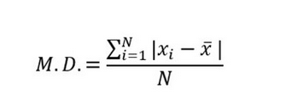
Mean Deviation
Average of absolute differences from the mean is known as mean deviation.
Calculate the mean for given data set.
Find out the absolute difference of each data value from mean
Add all the values you calculated in second step and divide by total number of data values

Slide 10
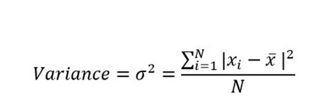
Variance
The Variance is the average of squared differences from the mean.
Calculate the mean of data values
Find out the absolute difference of each data value from mean
Square each absolute difference you find
Take the mean of all squared values from step 3.

Slide 11
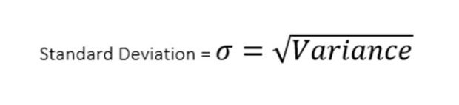
Standard Deviation
The Standard Deviation is the square root of variance.

Slide 12
Measures of Central Tendency
measures of central tendency are a set of “middle” values representative of the data points.
Central tendency describes the distribution of data focusing on the central location around which all other data are clustered.
It is the opposite of dispersion that measures how far the observations are scattered with respect to the central value.

Slide 13
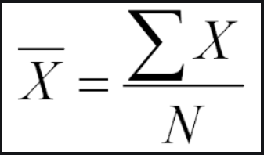
Mean
Mean is the average of some data points.

Slide 14
Median
Median is the number at the center of a series after they are ordered (ascending or descending).
2,3,4,5,6
4, 7, 6, 2, 10, 8

Slide 15
Mode
[1,2, 3, 4, 5,5] — the most frequently occurring one is 5; that’s mode.
A distribution can have more than one mode as in the list [2, 2, 3, 4, 4]; it’s called bimodal distribution of a discrete variable.
Along this logic, a distribution with more than two modes are called multimodal distribution.

Slide 16
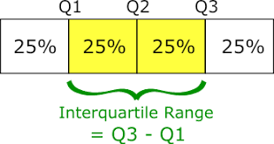
Quartiles — Quartiles are the points in the data set that divides the data set into four equal parts. Q1, Q2 and Q3 are the first, second and third quartile of the data set.
25% of the data points lie below Q1 and 75% lie above it.
50% of the data points lie below Q2 and 50% lie above it. Q2 is nothing but Median.
75% of the data points lie below Q3 and 25% lie above it.

Slide 17
Skewness
Skewness is the measure of symmetry or asymmetry of data distribution.
A distribution or data set is said to be symmetric if it looks the same to the left and right points of the center.
Type
Right skewness or Positive skewness
Left skewness or Negative skewness

Slide 18

Positive Skew — This is the case when the tail on the right side of the curve is bigger than that on the left side. For these distributions, mean is greater than the mode.
Negative Skew — This is the case when the tail on the left side of the curve is bigger than that on the right side. For these distributions, mean is smaller than the mode.
The most commonly used method of calculating Skewness is

Slide 19
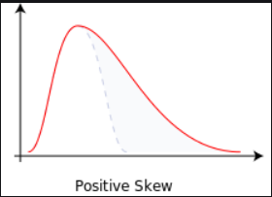
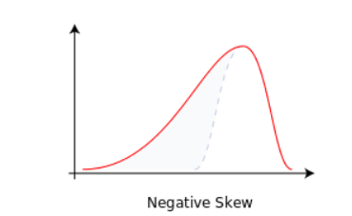
Right skewness
A right-skewed distribution will have a long tail in the right direction on the number line such that the mean of the total value of all data points will eventually go up.
Left skewness
A left-skewed distribution will have a long tail in the left direction on the number line such that the mean of the total intrinsic value of all data points will eventually go down.

Slide 20
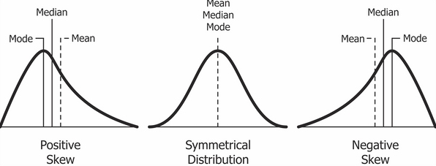
If the skewness is zero, the distribution is symmetrical. If it is negative, the distribution is Negatively Skewed and if it is positive, it is Positively Skewed.

Slide 21
Kurtosis
Kurtosis is the characteristic of being flat or peaked. It is a measure of whether data is heavy-tailed or light-tailed in a normal distribution
Percentile coefficient of Kurtosis
Ku=Q / (P90 — P10)
Where,
Q= Quartile deviation
P90=90th percentile
P10=10th percentile
A large value of kurtosis is often considered as riskier because data may tend to give an outlier value as an outcome with greater distance from the mean if applied to any machine learning algorithm.

Slide 22
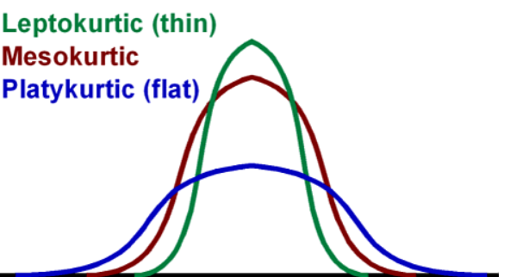
Types of Kurtosis
Mesokurtic
Leptokurtic
Platykurtic
Mesokurtic
This distribution has the tails often similar to normal distribution.
Leptokurtic
This distribution will be having very long and skinny tails. This means there are more chances of the presence of outliers.
Platykurtic
This distribution will be having very low and stretched around center tails which means most of the data points are present in high proximity with mean.

Slide 23
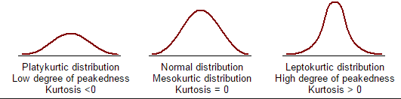
Mesokurtic — This is the case when the kurtosis is zero, similar to the normal distributions.
Leptokurtic — This is when the tail of the distribution is heavy (outlier present) and kurtosis is higher than that of the normal distribution.
Platykurtic — This is when the tail of the distribution is light( no outlier) and kurtosis is lesser than that of the normal distribution.

Slide 24
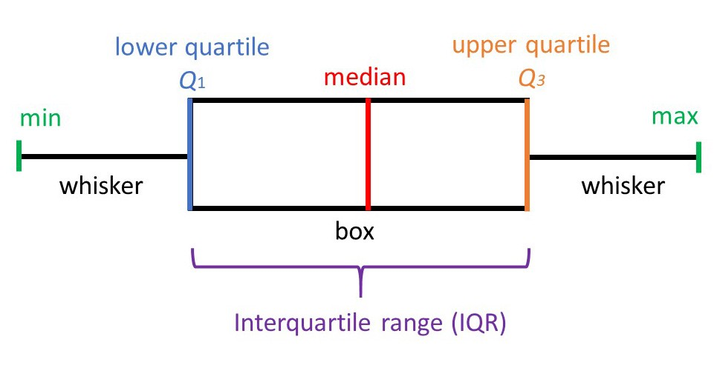
Detecting outliers using Box-And-Whisker Diagrams and IQR

Slide 25
Minimum Value: It is the least numerical value of a dataset. This defines the left boundary.
Median (Q2): It is the number that divides the data into two halves. If the number of numbers in the data is ODD, the median number is the middle data value. If the number of numbers in the data is EVEN, the median number is the mean of the two middle data values. This is only applicable if the numbers in the dataset are arranged in increasing/ascending order.
Lower Half: It is the set of values that lie to the left of the Median (Q2)
Upper Half: It is the set of values that lie to the right of the Median (Q2)
Q1 (25th Percentile): It is the median of the lower half of the dataset.
Q3 (75th Percentile): It is the median of the upper half of the dataset.
Maximum Value: It is the greatest numerical value of a dataset. This defines the right boundary.
Range: It is the difference between the maximum and the minimum value.
Interquartile Range (IQR): It is the difference between Q3 and Q1.

Slide 26
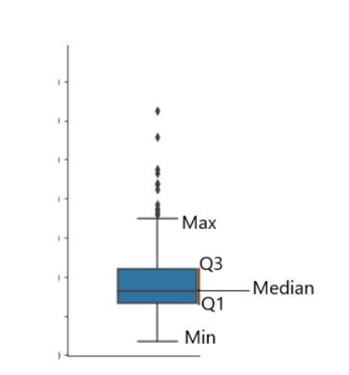
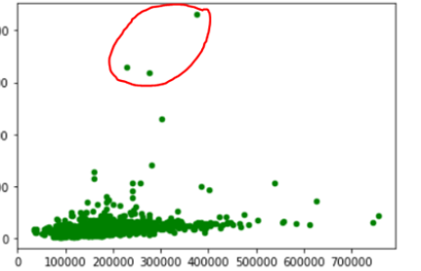

Slide 27
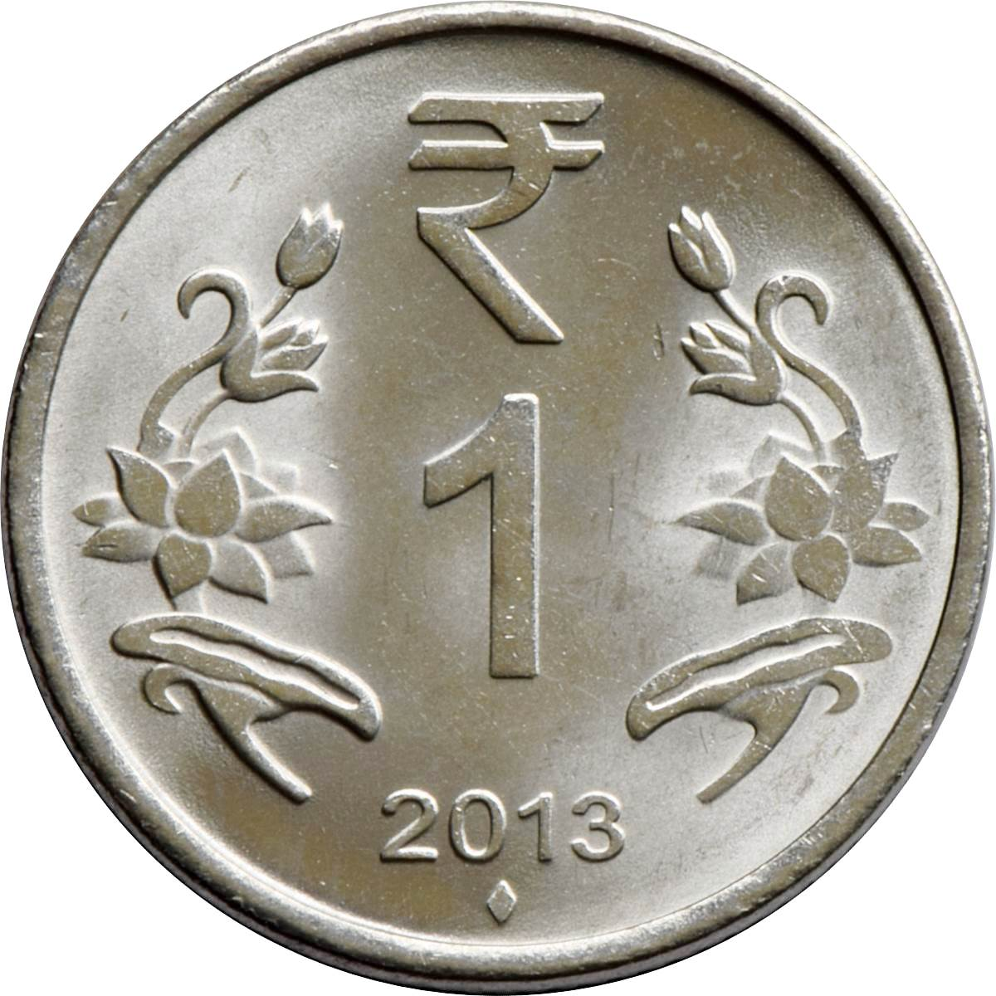
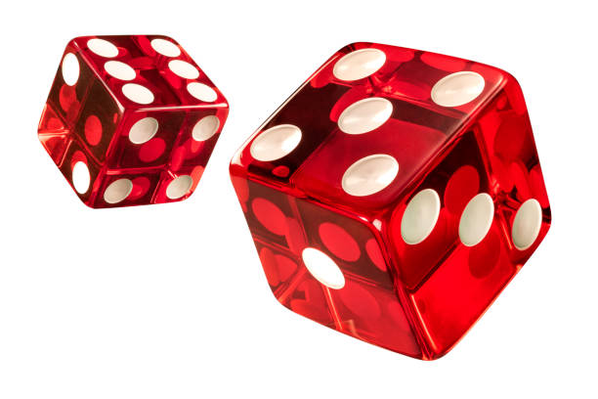
Probability :How likely something is to happen.
Tossing a Coin
When a coin is tossed, there are two possible outcomes:
heads (H) or
tails (T)
We say that the probability of the coin landing H is ½
And the probability of the coin landing T is ½
When a single die is thrown, there are six possible outcomes: 1, 2, 3, 4, 5, 6.
The probability of any one of them is 1/6
Probability of an event happening = Number of ways it can happen Total number of outcomes

Slide 28
Experiment: a repeatable procedure with a set of possible results.
Example: Throwing dice
We can throw the dice again and again, so it is repeatable.
The set of possible results from any single throw is {1, 2, 3, 4, 5, 6}
Sample Space: all the possible outcomes of an experiment.
Example: choosing a card from a deck
There are 52 cards in a deck (not including Jokers)
So the Sample Space is all 52 possible cards: {Ace of Hearts, 2 of Hearts, etc... }
Outcome: A possible result of an experiment.
Example: Getting a "6"
Sample Point: just one of the possible outcomes
Example: Deck of Cards
the 5 of Clubs is a sample point
the King of Hearts is a sample point
"King" is not a sample point. There are 4 Kings, so that is 4 different sample points.
Event: one or more outcomes of an experiment
Example Events:
An event can be just one outcome:
Getting a Tail when tossing a coin
Rolling a "5"
An event can include more than one outcome:
Choosing a "King" from a deck of cards (any of the 4 Kings)
Rolling an "even number" (2, 4 or 6)

Slide 29
Dependent Events where what happens depends on what happened before, such as taking cards from a deck makes less cards each time.
Independent Events which we learn about here.
Independent Events
Independent Events are not affected by previous events.
A coin does not "know" it came up heads before.
And each toss of a coin is a perfect isolated thing.
"P" to mean "Probability Of", So, for Independent Events:
P(A and B) = P(A) × P(B)
Probability of A and B equals the probability of A times the probability of B

Slide 30
Example 1: A coin is thrown 3 times .what is the probability that atleast one head is obtained?
Example 2: Find the probability of getting a numbered card when a card is drawn from the pack of 52 cards.
Example 3: There are 5 green 7 red balls. Two balls are selected one by one without replacement. Find the probability that first is green and second is red.

Slide 31
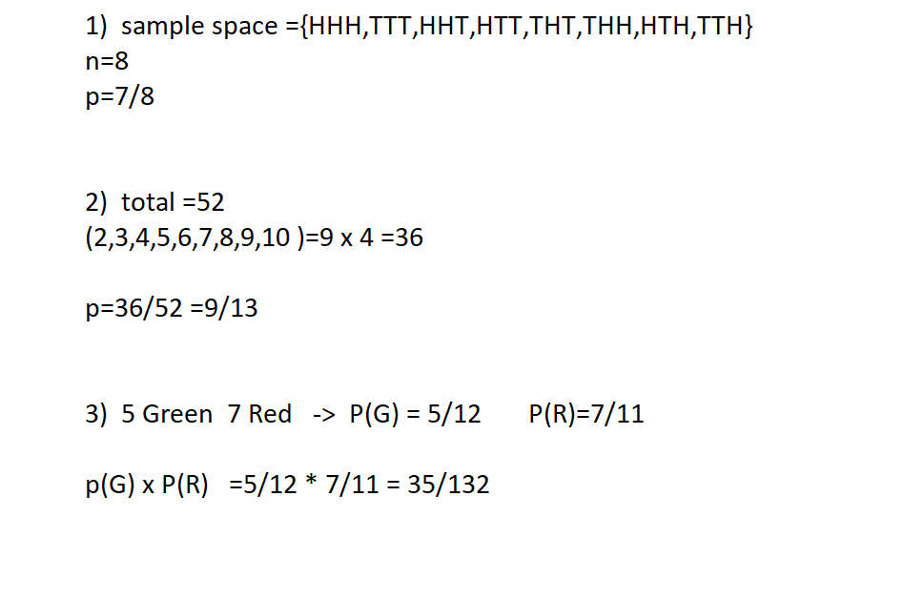
Answers:

